Slide 1
Introduction to Deep Learning
Day 1
Teachers: Pranav Chandramouli, Sven van der Burg, Laura Ootes
Helpers: Laura Ootes, Luisa Orozco
Digital Skills

Slide 2
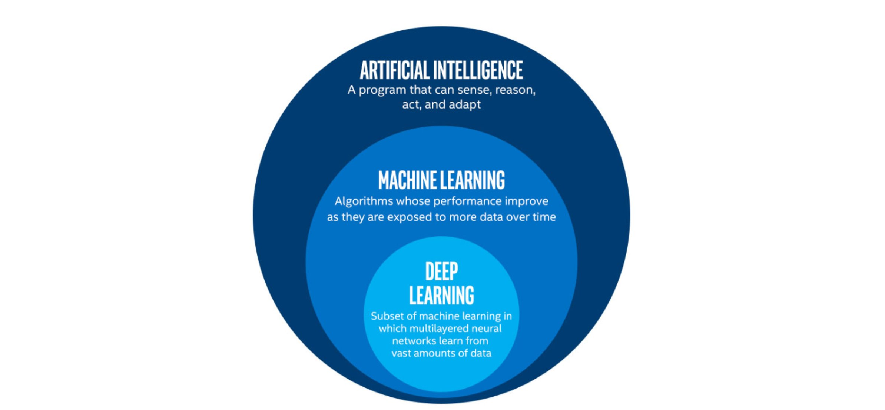
What is Deep Learning?

Slide 3
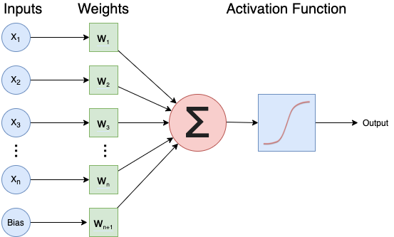
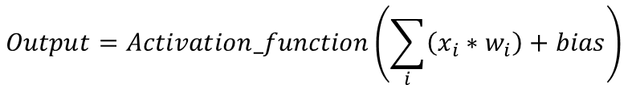
Neural Networks
$$Output=Activation_function\left(\sum_{i}{\left(x_{i}∗w_{i}\right)+bias}\right)$$

Slide 4
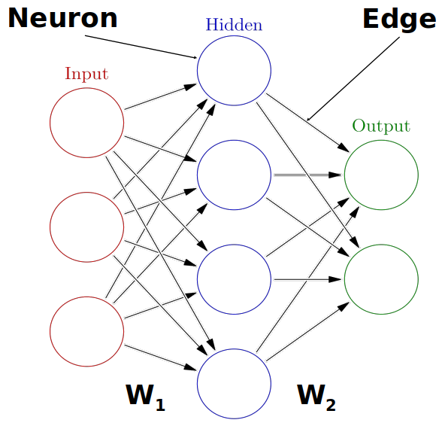
Neural Networks
https://playground.tensorflow.org/

Slide 5
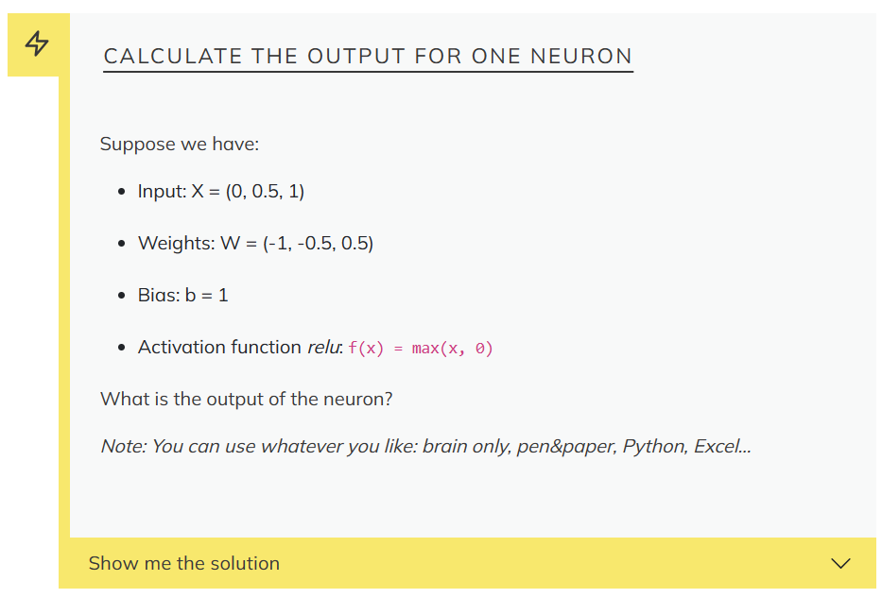

Slide 6
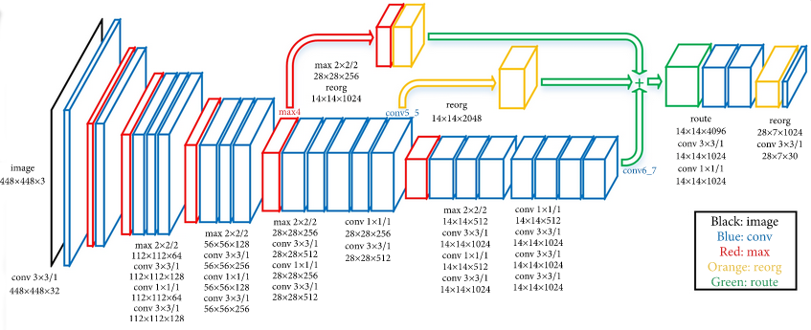
Example of a Deep Neural Network
“An Efficient Pedestrian Detection Method Based on YOLOv2” by Zhongmin Liu, Zhicai Chen, Zhanming Li, and Wenjin Hu, published in Mathematical Problems in Engineering, Volume 2018

Slide 7
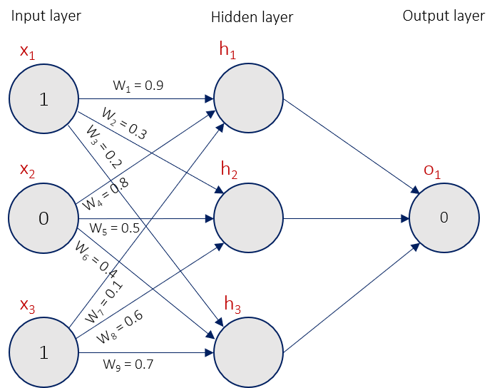
How do Neural Networks learn?
Loss Function
*Neural Network: A Complete Beginners Guide - Gadictos

Slide 8
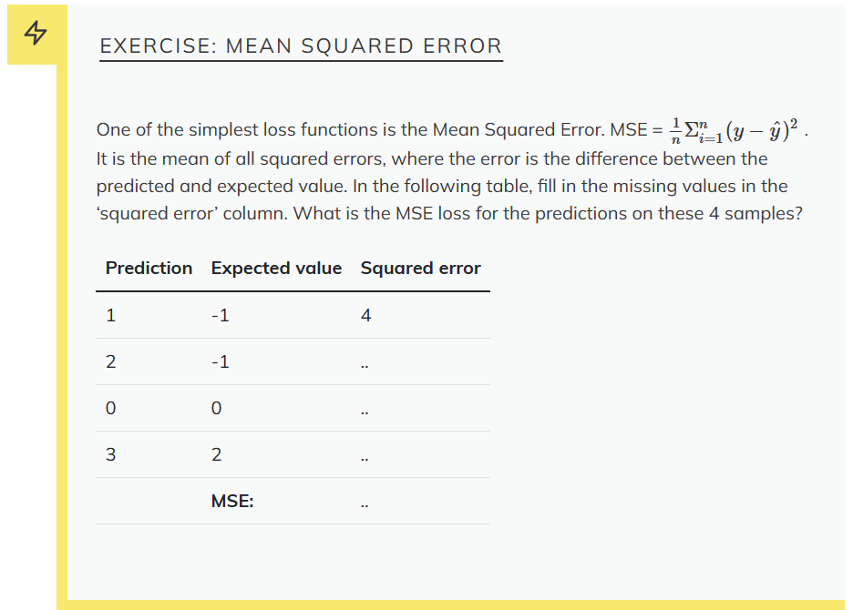

Slide 9
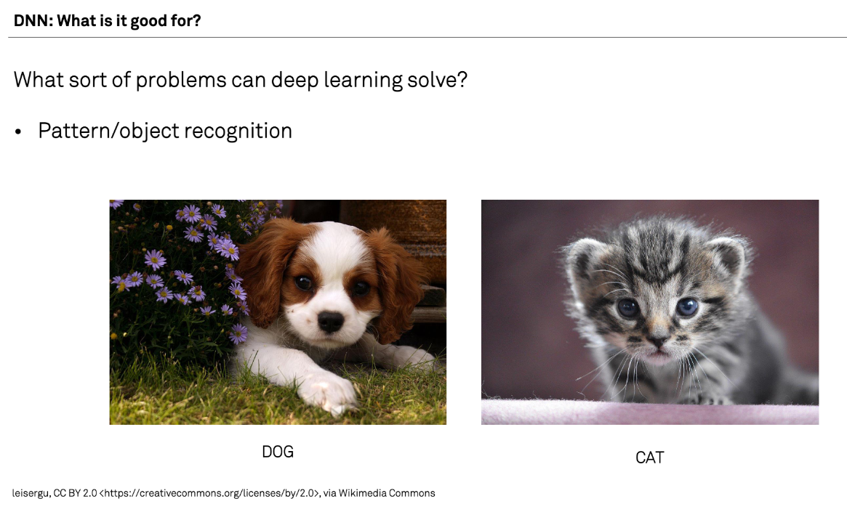

Slide 10
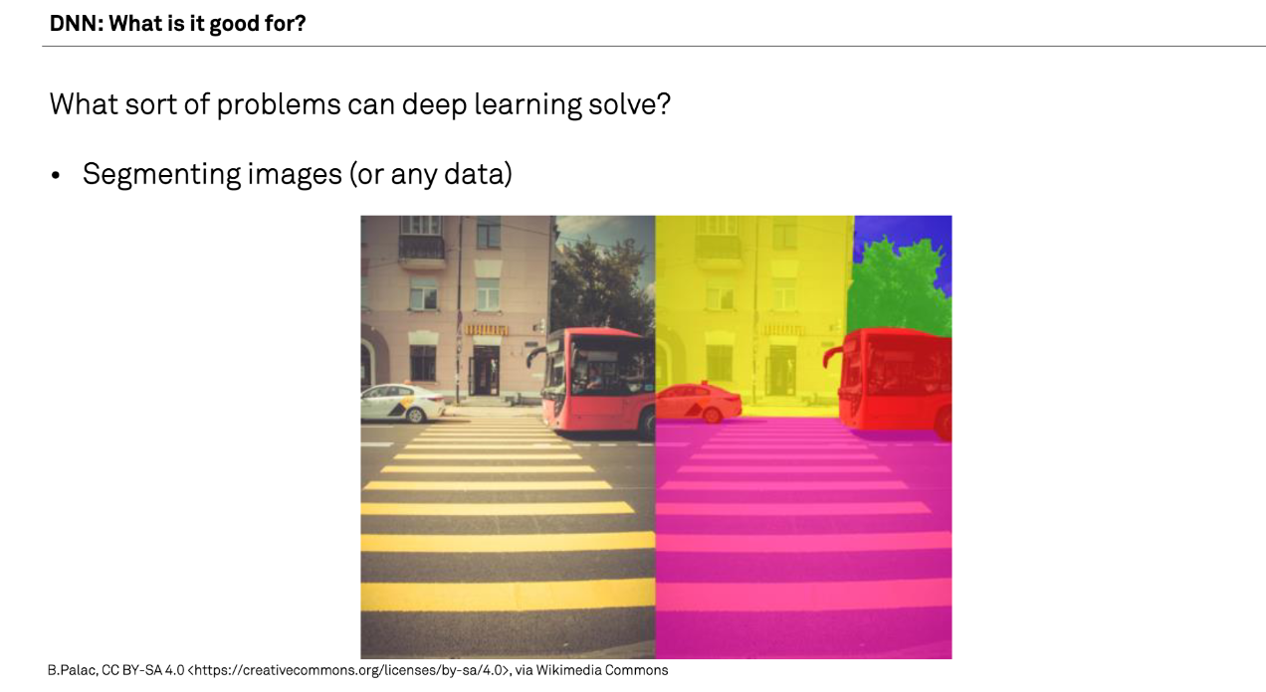

Slide 11
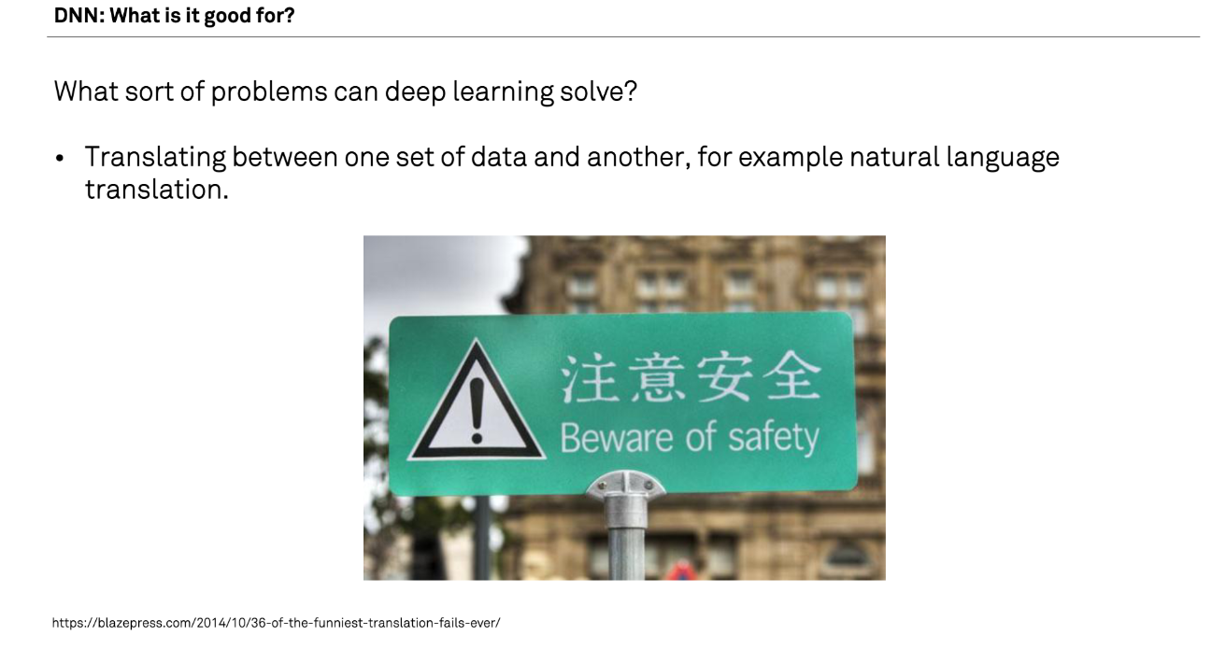

Slide 12
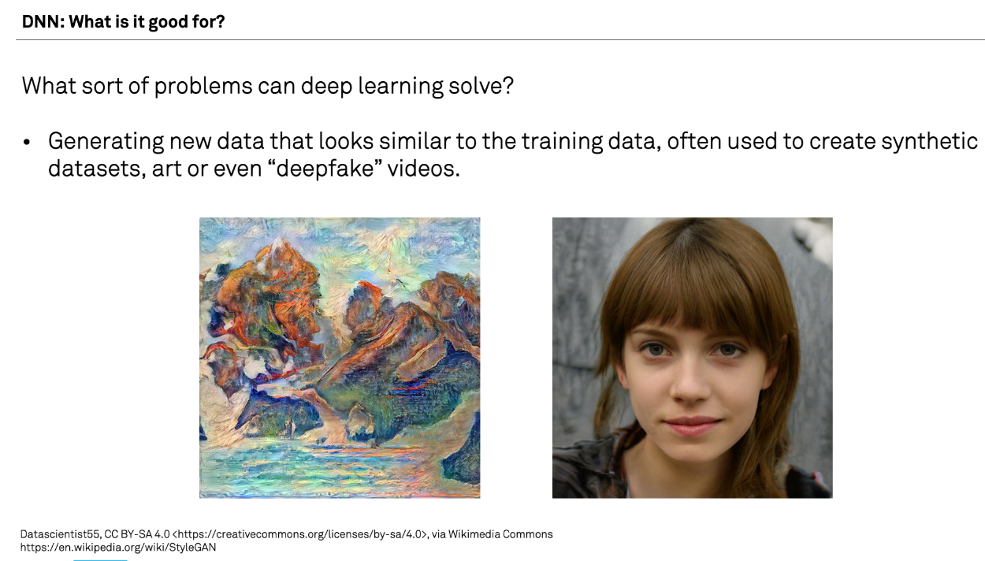
DNN: What is it good for?
What sort of problems can deep learning solve?
Generating new data that looks similar to the training data, often used to create synthetic datasets, art, or deepfake videos. A recent famous example: chatGP

Slide 13
What problem can't it solve?
Any case where only a small amount of training data is available.
Tasks requiring an explanation of how the answer was arrived at.
Classifying things which are nothing like their training data.

Slide 14
When is it Overkill?
Logic operations, such as computing totals, averages, ranges etc. (see this example applying Deep Learning to solve the “FizzBuzz” problem often used for programming interviews)
Modelling well defined systems, where the equations governing them are known and understood.
Basic computer vision tasks such as edge detection, decreasing colour depth or blurring an image.

Slide 15
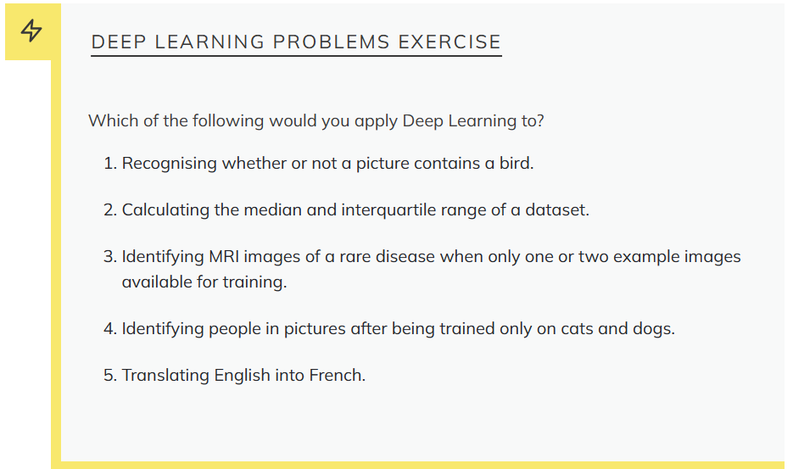

Slide 16
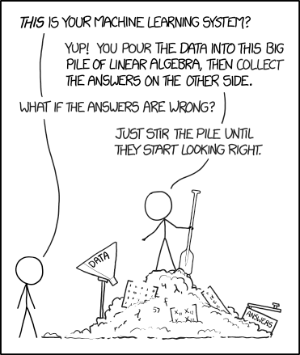
How much data is enough data?
xkcd: Machine Learning

Slide 17
Deep Learning Workflow
Formulate/ Outline the problem
Identify inputs and outputs
Prepare data
Choose a pre-trained model or build a new architecture from scratch
Choose a loss function and optimizer
Train the model
Perform a Prediction/Classification
Measure Performance
Tune Hyperparameters
Share Model

Slide 18
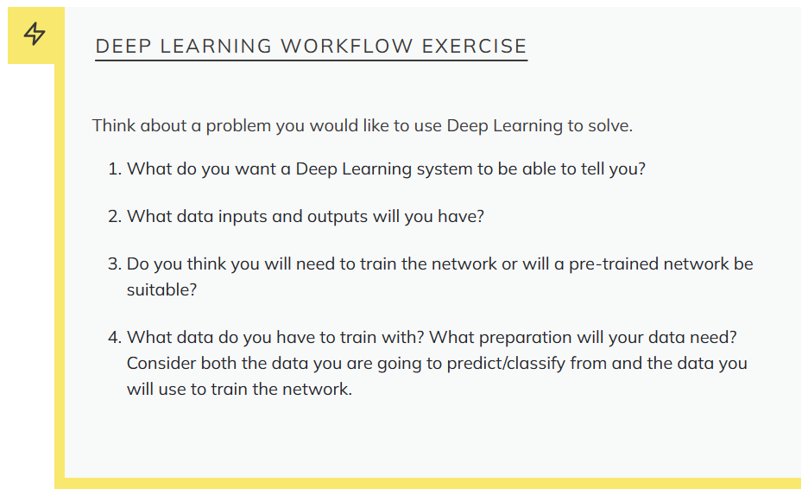

Slide 19



Deep Learning Libraries

Slide 20

Setup Testing

